Slide 1
Nakuja Internship 2026
Solid Propulsion Team
Weekly report #8
Presented by: Bravin Limuli
August 7, 2026

Slide 2
This week’s tasks
Update of static test procedure
Cooking of grains for 3 grain static test
Ignition circuit fabrication
Liner preparation
Purchasing of items

Slide 3
Update of static test procedure
Purpose: Upon discussion with the supervisors, we decided to perform 3 static tests before mass production begins.
Here is the critical path documentation for the three planned static tests: https://github.com/nakujaproject/Internship-2026/blob/main/01_SOLID_PROPULSION/Static_Tests/N4%20Version%201%20%26%202%20%E2%80%93%20Final%20Test%20Campaign%20%26%20Launch%20Preparation.pdf
Static Test number | Casing material | No. of grains | Date planned
8 | Aluminium 6063-T5 | 3 | Monday 17/08/2026
9 | Stainless steel G 304 SCH 10 | 4 | Friday 21/08/2026
10 | Aluminium 6063-T5 | 5 | Monday 24/08/2026

Slide 4
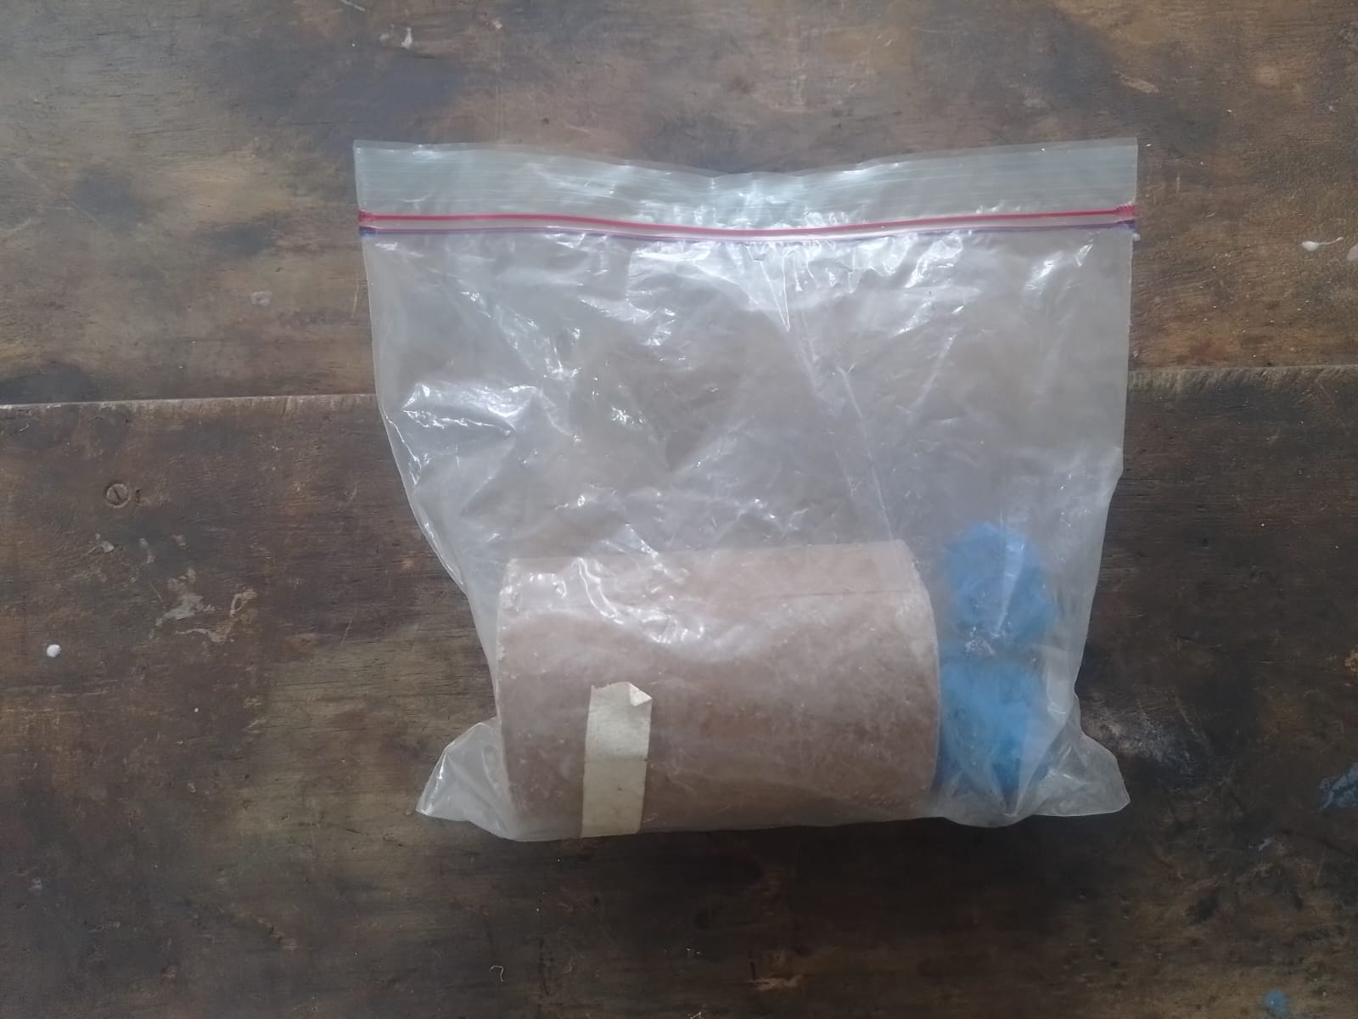
2. Cooking of grains
Purpose: In-line with the planned static tests, the propellant sub-team has started grain preparation which will be used for the 3 grain test.
Result: 1 out of the planned 12 grains has already been prepared.

Slide 5
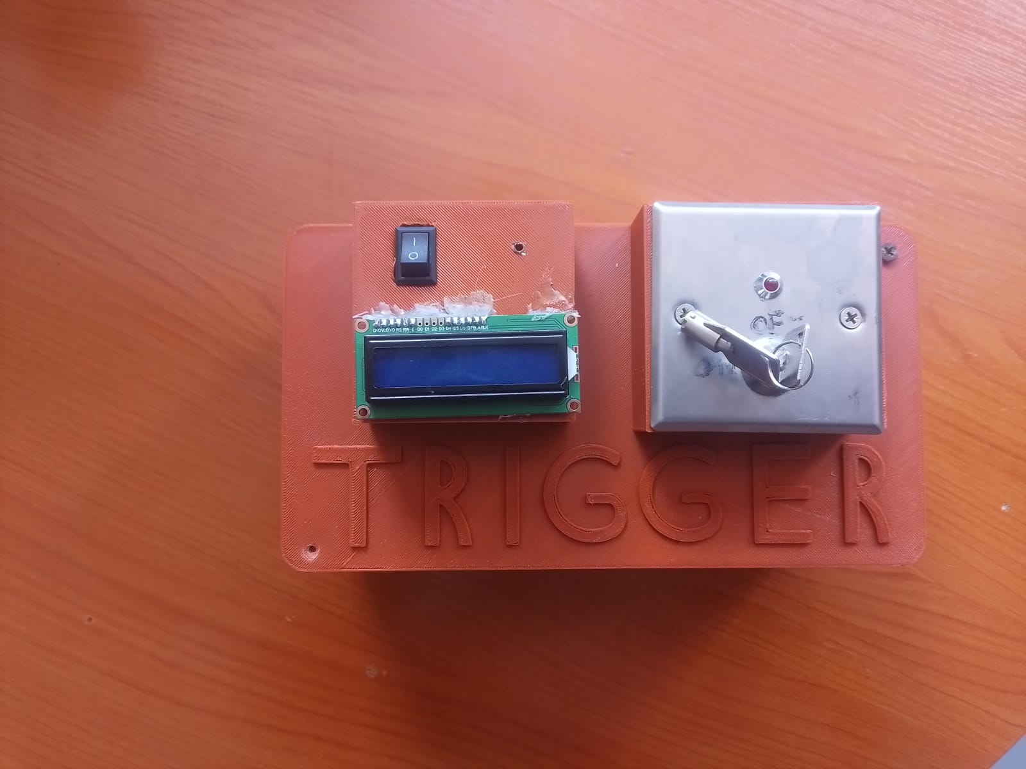
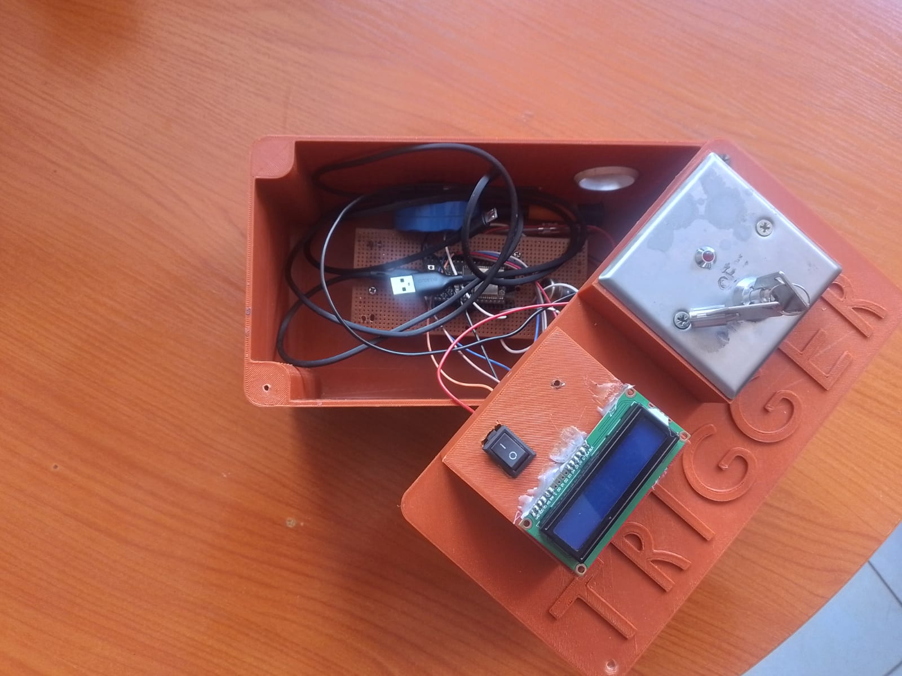
3. Ignition circuit fabrication
Purpose: In preparation for the upcoming static test campaign, the ignition circuit sub team has been fabricating a new ignition circuit which will be used.
Changes made:
Use of a perfboard instead of Printed Circuit Board (PCB) for easy repair and maintenance
Use of a relay instead of MOSFET
Addition of 3D printed case to improve reliability and protection during field tests

Slide 6
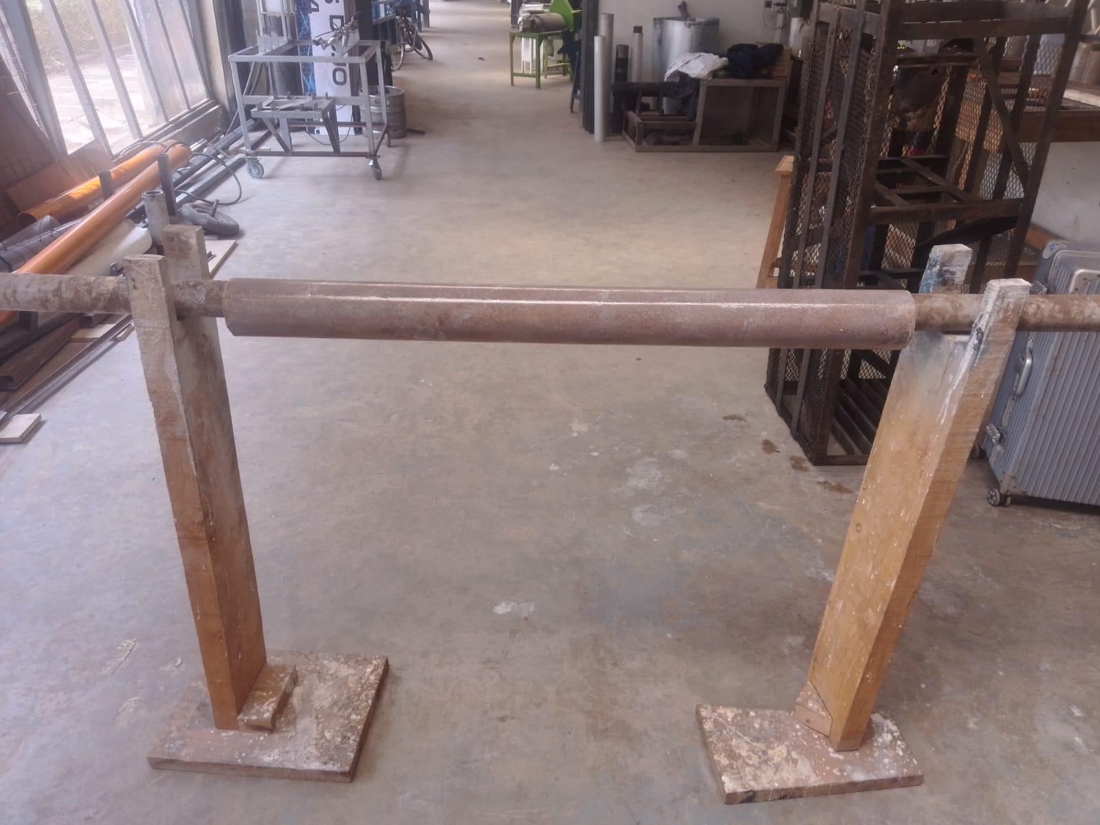
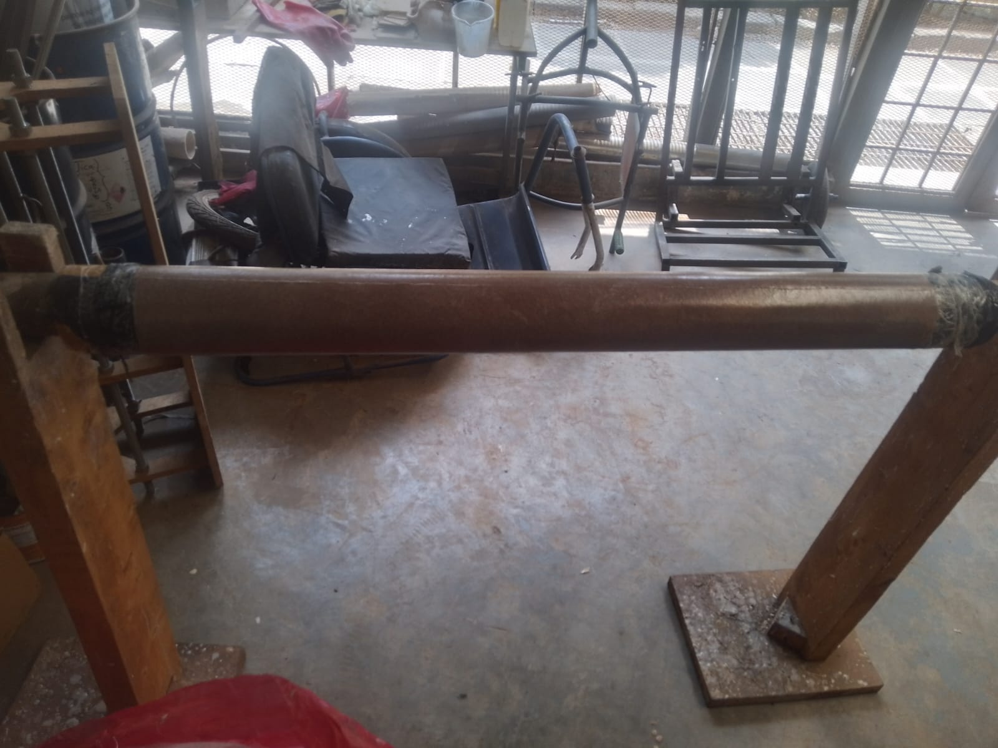
4. Liner preparation
Purpose: In preparation of the static tests, we have fabricated 2 liners and both can fit the Aluminium and Stainless Steel fabrication.
Result: 2 out of 4 liners have been fabricated

Slide 7
5. Purchasing of items
Purpose: In preparation for the upcoming static test, critical materials have to be purchased, here is the link to the purchase request for the 2nd disbursement: https://docs.google.com/spreadsheets/d/1ItQDAlRLaYcg9si493R-wpe7q-Kaqn-85Dn_sr7F3AY/edit?gid=1592499292#gid=1592499292

Slide 8
Next week's tasks
Cooking of grains for 3 grain and 5 grain static tests
Machining of core rods
Motor assembly for 3 grain test
Static test dry run (To test new ignition circuit hardware)
Liner preparation

Slide 9
Challenges experienced
Poor internet connectivity.
Supervisors’ note:
Visit Solid Propulsion github projects @ https://github.com/orgs/nakujaproject/projects/26 to review the tasks done.

Slide 10
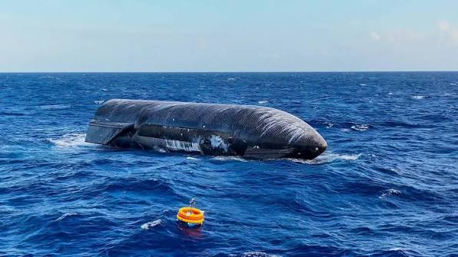
Thank you for your attention!

